Slide 1
Market Efficiency
James Chiu
Jarrett Fishpaw
Vinson Pham
Nick Jozefczyk

Slide 2
Efficiency Market Hypothesis
It is impossible to "beat the market" because stock market efficiency causes existing share prices to always incorporate and reflect all relevant information.
This means that stocks always trade at their fair value on stock exchanges, making it impossible for investors to either purchase undervalued stocks or sell stocks for inflated prices.
Because of this, it should be impossible to outperform the overall market through expert stock selection or market timing, and that the only way an investor can possibly obtain higher returns is by purchasing riskier investments.

Slide 3
Degrees of Efficiency
Strong efficiency
  This is the strongest version, which states that all information in a market, whether public or private, is accounted for in a stock price. Not even insider information could give an investor an advantage.
Semi-strong efficiency
  This form of EMH implies that all public information is calculated into a stock's current share price. Neither fundamental nor technical analysis can be used to achieve superior gains.
Weak efficiency
  This type of EMH claims that all past prices of a stock are reflected in today's stock price. Therefore, technical analysis cannot be used to predict and beat a market.

Slide 4
Article 1
Good News for Value Stocks:
Further Evidence on
Market Efficiency
Rafael La Porta
Josef Lakonishok
Andrei Schleifer
Robert Vishny

Slide 5
Basic Definitions
Value Stock – a stock which has showed poor growth in the past and is expected to continue growing slowly. Ranked lowest among stocks in growth in sales and ranked highest among stocks in cash-flow to price.
Glamour Stock – a stock (usually well known) that has showed high growth in the past and is expected to continue growing strongly. These stocks are ranked lowest in cash flow to price and ranked highest in growth in sales.

Slide 6
The Problem at Hand
Over the past, value strategies (portfolios consisting of value stocks) have produced superior returns to glamour strategy. This raises the question of whether such differences in returns is a result of compensation for risk (risk premium) or underlying behavioral factors. Of these behavioral factors, the one that is focused on in this study is the role of expectational errors in influencing investment.

Slide 7
Expectational Errors
The idea of expectational errors deals with the idea of investors extrapolating growth rates too far into the future. Essentially, investors assume current growth rates will be maintained far into the future, meaning that currently high-growing glamour stocks are expected to continue growing strongly. This is not the case however, as earnings resemble more of a random walk, and are impossible to predict too far into the future.

Slide 8
Expectational Errors Hypothesis
This hypothesis examines the market’s reaction to earnings announcements to determine whether investors make systematic errors in pricing.
To study this, we examine two sets of returns for the portfolios over the five-year period: Annual buy-and-hold returns (regular yearly returns) and earnings announcement returns (3-day returns centered around earnings announcements, from t-1 to t+1.)
We test the hypothesis by determining whether earnings surprises are systematically positive for value stocks and systematically negative for glamour stocks.

Slide 9
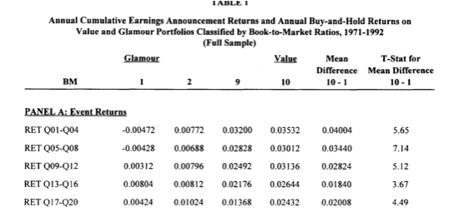
Results
It was found that event returns (earning announcement/earning surprises) are substantially higher for the value portfolios (around 3.5%) than for the glamour portfolios (-0.5%).

Slide 10
Results Cont’d
The t-statistic also shows the difference between the two sets of event returns is significant.
Substantially higher relative event returns persist for value stocks even 5 years after portfolio formation, with the effects gradually diminishing over time.

Slide 11
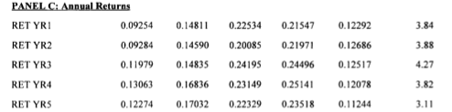
Results Cont’d
The return differences die out faster for events returns than for the annual buy-and-hold returns, suggesting earnings surprises are not the full story behind superior performance for value stocks.
Glamour
Value

Slide 12
Results Cont’d
These results suggest a significant portion of return differences between value and glamour portfolios is attributable to earnings surprises that are systematically more positive for value stocks.
This also suggests that learning about future earnings prospects is a slow process when it comes to pricing the information into stock prices.
The return differences for the event returns is a good indication of overall direction of returns for the value and glamour stocks, but not a good measure of overall magnitude.

Slide 13
Does this exist for larger firm’s stocks as well?
The question arises whether or not this difference in event returns plays as significant a role in the annual returns of stocks for larger, more well-known firms.
It was found that the difference in event returns for the stocks of larger firms is smaller and accounts for less of the total difference in returns between value and glamour stocks.
This could be the result of either:
  1. The pricing of stocks for larger firms being more efficient with less systematic bias.
  2. Since larger firms get more press coverage, information about the firms is more widespread outside of “events”, making such earnings announcements less meaningful. Essentially, more widely-followed stocks adjust to news more continuously.

Slide 14
What about Risk Compensation?
We’ve seen the effect of earnings surprises on the returns differences between glamour and value stocks. Now we look at the possible role of risk compensation in the return differential.

Slide 15
Risk Premium
It would be assumed that the higher returns for value stocks is an indication of a higher risk premium being attached to the stocks.
This is NOT the case however, as the return on glamour stocks in years t+1 and t+1 is actually negative (~0.5%) suggesting a negative ex ante risk.
Risk premium= r-rf = B (exp. market return-rf)
r-rf is negative indicating that investors should be looking to sell off such value stocks if they have a positive ex ante risk, which glamour stocks certainly do.

Slide 16
Risk Cont’d
Risk premium COULD however possibly be used to explain the significant portion of returns realized by value stocks around earnings reports. At these events, a significant amount of uncertainty is cleared up as earnings are announced, suggesting a disproportionately large share of risk premium should be realized as well.
This makes us examine a different understanding of risk premium, where for both glamour and value stocks, the event returns should be higher than non-event returns.

Slide 17
Risk Cont’d
Looking at the results:
For Glamour stocks, the event returns are less than the non-event returns. This can only be explained by the market receiving negative surprises for glamour firms on event days.
This also does not support the risk premium view.

Slide 18
Conclusions
There are many conclusions that can be garnered from these tests, many of them already mentioned in this presentation. They are:
  The event returns for Value stocks, often featuring positive earnings surprises, are significantly greater than those for Glamour stocks, although this difference diminishes over time.
  The non-event return for Glamour stocks is greater than the event return, which is inconsistent with the risk premia explanation for the differences in returns.
  The event returns for large firms is often less than those for small firms, as large firms have more widely followed stocks that adjust to news more continuously throughout the quarter, diminishing the importance of earnings surprises.

Slide 19
Final Thought
Given these return differentials between Value and Glamour stocks, why is it that Glamour stocks are still so widely held?
There are a couple possible explanations for this:
1. Investors may prefer “good” companies that have superior past growth records. Often, such stocks are perceived as being less risky than value stocks. Another test by LSV (the authors) has actually disproven this notion by showing that value stocks are actually less risky than glamour.
2. Institutional investors may prefer well known glamour stocks because they are easier to justify to their clients. Such investment managers are interested in increasing their clients investment, and glamour firms can help make such clients feel safer. Another test by LSV shows this tendency of institutional investors to overweight portfolios with glamour stocks. It is suggested that this could be the single greatest reason for the overall underperformance of investment managers relative to the S&P 500 over the last 20+ years.

Slide 20
Article 2
Time-varying betas and asymmetric effects of news:
empirical analysis of
blue chip stock

Slide 21
Goal:
To determine whether an asymmetric/ leverage effect exist between stock
Or
Does beta increases with bad news and decreases with good news, just as does volatility?

Slide 22
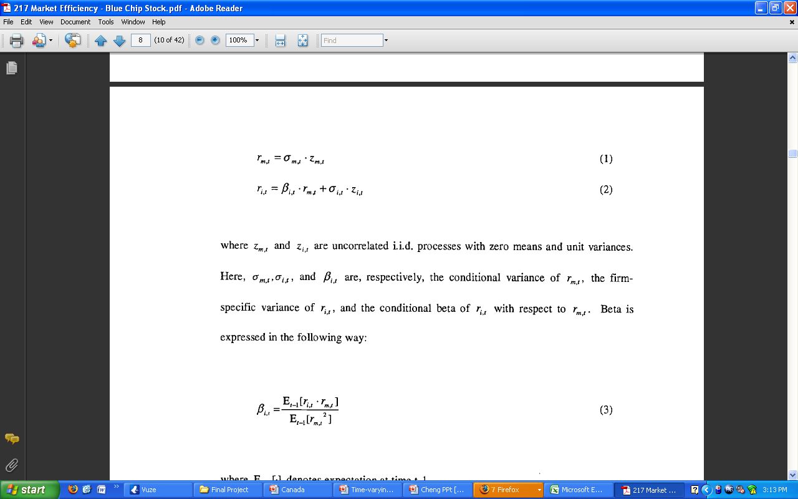
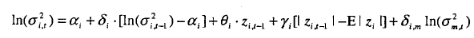
How Beta relates to Stock Price
Demanded Market Returns
Demanded Individual Firm Returns
Idiosyncratic Beta
How the Idiosyncratic and Market Beta’s are related:
Idiosyncratic Beta
Market Beta

Slide 23
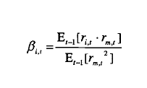
Finding Beta
Demanded Individual Firm Returns
Demanded Market Returns

Slide 24
Data collected from:
Apple
AT&T
Bank of America
Bell Atlantic
Chase
Coca-Cola
Compaq
Disney
Ford
Exxon
GAP
General Electric
Hewlett Packard
IBM
Intel
Johnson & Johnson
JP Morgan
McDonald
Merck
Microsoft
Motorola
Nordstrom
Sears
Sun
Time Warner

Slide 25
Known:
Volatility tends to rise following negative returns and fall following positive returns
The asymmetric effect of news on volatility has been addressed in terms of two mechanisms:
  Financial and operational leverage
  Determinants of market risk premium
All firms stock beta’s are affected from at least one of these two market forces. This leaves three models:
  Idiosyncratic Model
  Market Model
  Joint Model

Slide 26
1. Leverage Effect
If the value of a leveraged firm drops, then its equity becomes more highly leveraged.
This causes an increase in volatility.

Slide 27
2. Market Risk Premium
Expected market risk premium is an increasing function of market volatility.
An increase in market volatility implies a increase in expected return
This lowers the stock price, contributing to the asymmetric effect in volatility

Slide 28
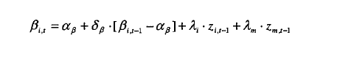
Estimating Beta
The individual firms effects (i) and the Market effects, (m) terms allow for leverage effects in the conditional betas
  Suggested by Chan (1988) and Ball and Kothari (1989).
If (i) is negative, the conditional beta rises in response to negative idiosyncratic returns (non-market returns) and drops in response to positive idiosyncratic returns.
Similarly, if (m) is negative, the conditional beta rises in response to negative market returns and drops in response to positive market returns.

Slide 29
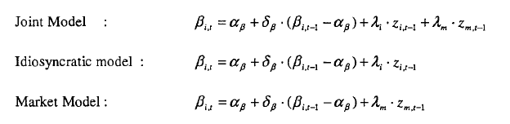
Multiple Models
The same estimator applies to all models

Slide 30
What this shows:
This evidence implies a way of explaining a time-varying beta
If the risk premium is an increasing function of the volatility, and beta is a measure of sensitivity to risk, then the asymmetric effect in volatility may imply such an effect in beta too
It suggests the possible existence of a positive relation between beta and volatility of individual stock return since these may be related to each other through asymmetric effects to news.

Slide 31
Expected outcome
The time variation of beta is a factor of:
  The Firm’s leverage
  The Market

Slide 32
Results
Joint Model | Idiosyncratic Model | Market Model
Coca Cola | Exxon | Disney
Merck | Microsoft | Bell
General Electric | Apple | Nordstrom
Sears | Johnson & Johnson | TW
Bank of America | Sun | AT&T
Chase | Motorola
HP
Gap
JP Morgan
McDonalds
Intel
Compaq
Ford

Slide 33
Our Project
We would like to attempt to apply their hedging strategy by combining a portfolio with both stocks
  Idiosyncratic Model
  Market Model
This will allow us to:
  Test efficiency in the market
  Test this model’s ability to hedge risk
We will also compare these results to a similar portfolio designed around glamour and value stocks

